Slide 1
scRNA-Seq SBG Pipeline Evaluation
06-03-2021
Nathan, Yonghong, Yaoyu

Slide 2
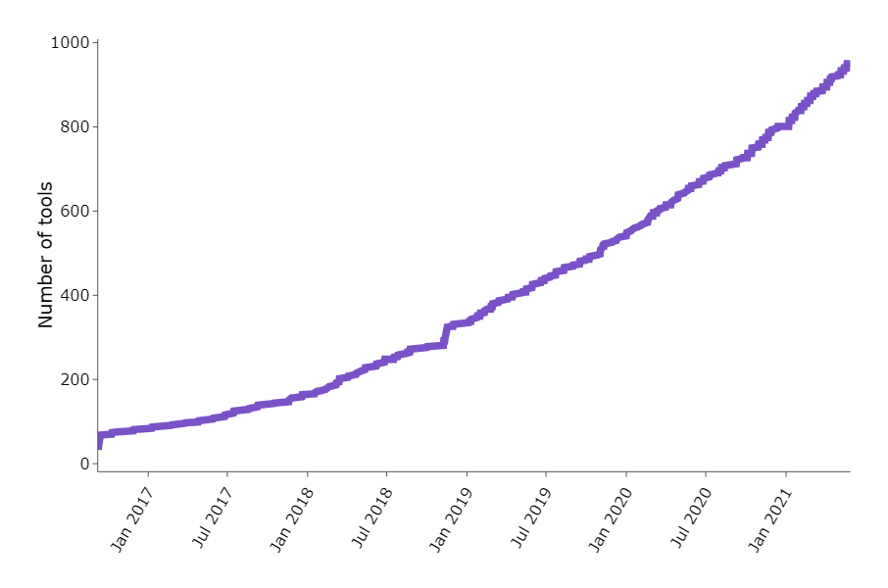
Outline
Overview of a typical scRNA-Seq analysis workflow
Overview of H3 scRNA-Seq evaluation
Need feedback on what questions H3 would want to ask
Number of New scRNA-Seq Tools
Zappia L, Phipson B, Oshlack A. "Exploring the single-cell RNA-seq analysis landscape with the scRNA-tools database", PLOS Computational Biology (2018), DOI: 10.1371/journal.pcbi.1006245

Slide 3
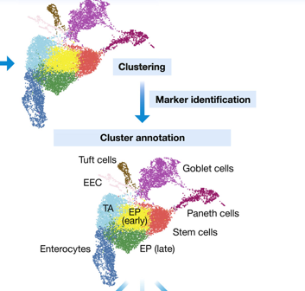
How to draw biologically meaningful insights from scRNASEQ
Identifying cell types or cell states of interest
Visualization of dimensionality reduction : PCA, tSNE, UMAP
Clustering : kmeans , graph-based, hierarchical
Marker gene detection: DEG analysis between clusters and doing pathway analysis
Trajectory inference: ordering cells along a pseudotime trajectory where pseudotime is calculated based on expression similarities of neighboring cells

Slide 4
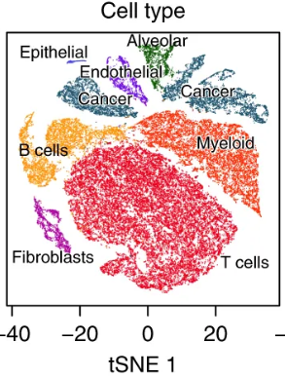
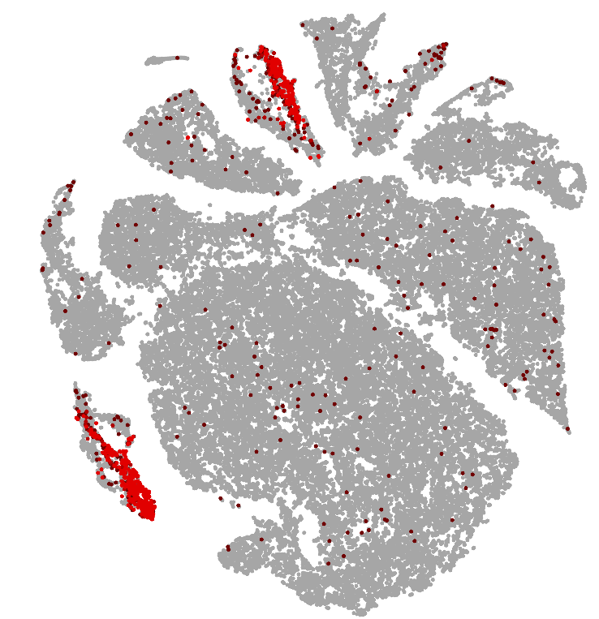
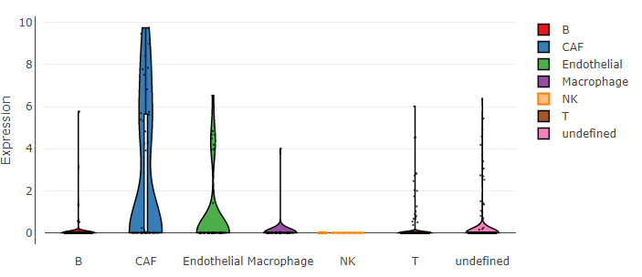
POSTN seems to be expressed on CAFs and endothelial cells
Lung Adeno Singlecell RNASEQ
Melanoma Tumor Singlecell RNASEQ
doi: 10.1126/science.aad0501
NSCLC Lung Atlas – (Lambrechts lab)

Slide 5
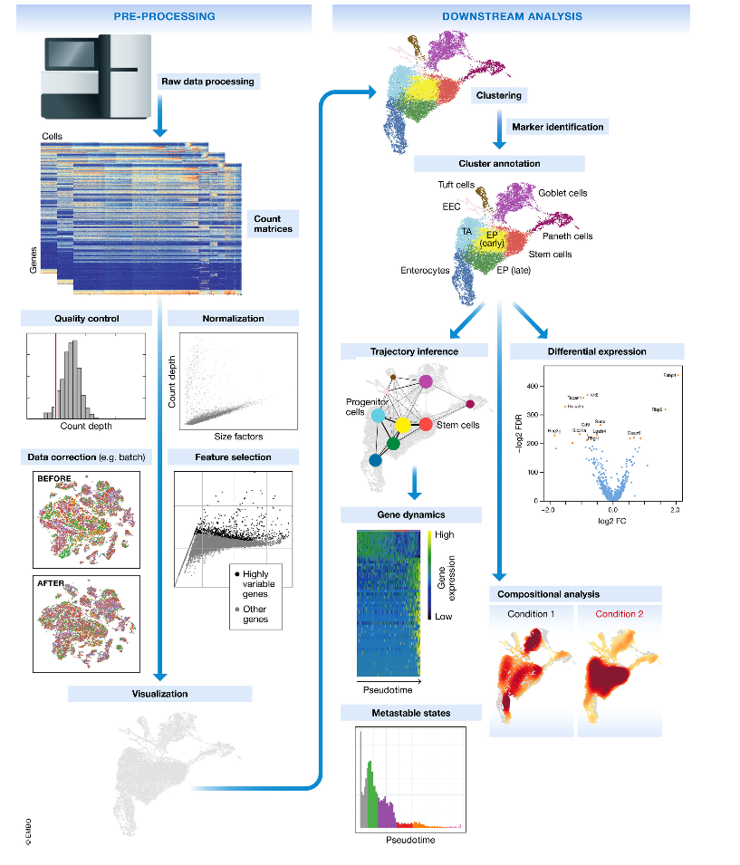
A Typical scRNA-Seq Analysis Workflow
Extensive Quality Control and pre-processing
Cluster the single cells
Identify single cell type
Explore the range of single cell states
Differential analysis between clusters, types, states
Compare the above between biological conditions
Luecken, Malte D., and Fabian J. Theis. "Current best practices in single‐cell RNA‐seq analysis: a tutorial." Molecular systems biology 15.6 (2019): e8746.

Slide 6
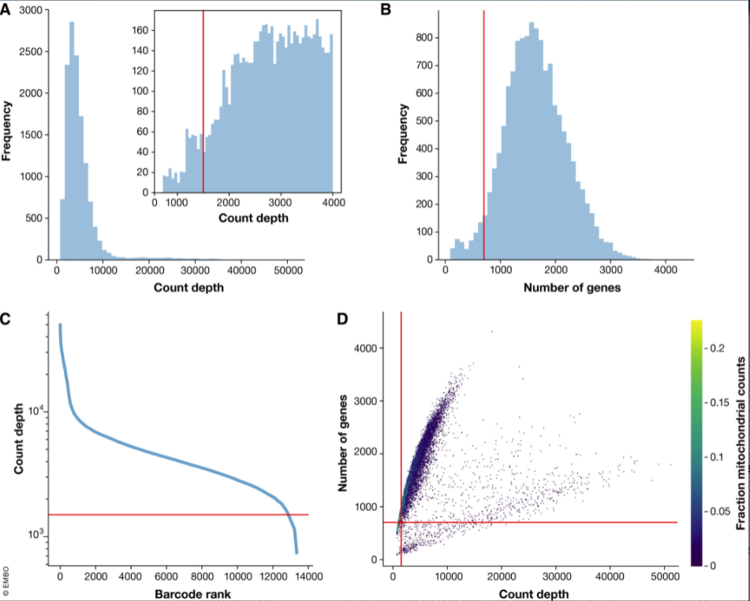
scRNA-Seq Basic Quality Control
Luecken, Malte D., and Fabian J. Theis. "Current best practices in single‐cell RNA‐seq analysis: a tutorial." Molecular systems biology 15.6 (2019): e8746.

Slide 7
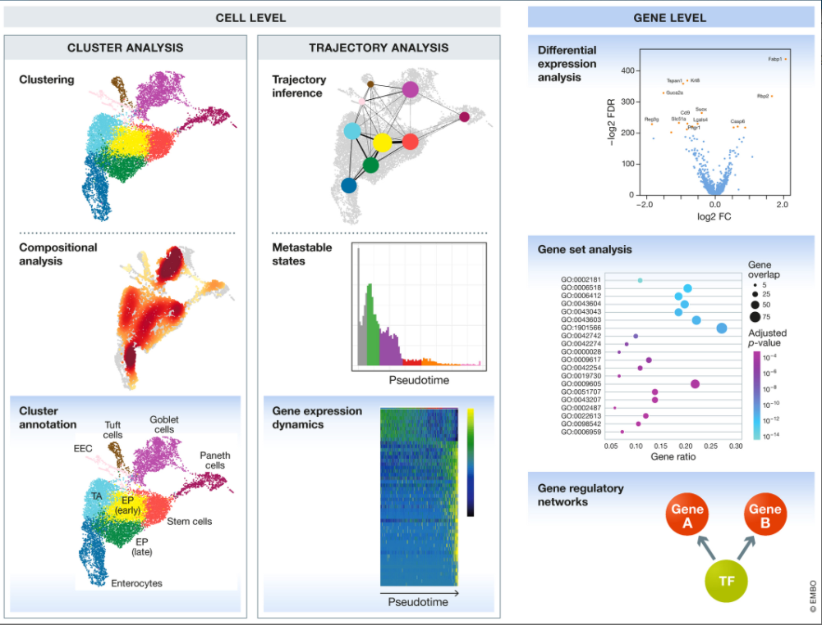
scRNA-Seq Cluster Analysis
Luecken, Malte D., and Fabian J. Theis. "Current best practices in single‐cell RNA‐seq analysis: a tutorial." Molecular systems biology 15.6 (2019): e8746.

Slide 8
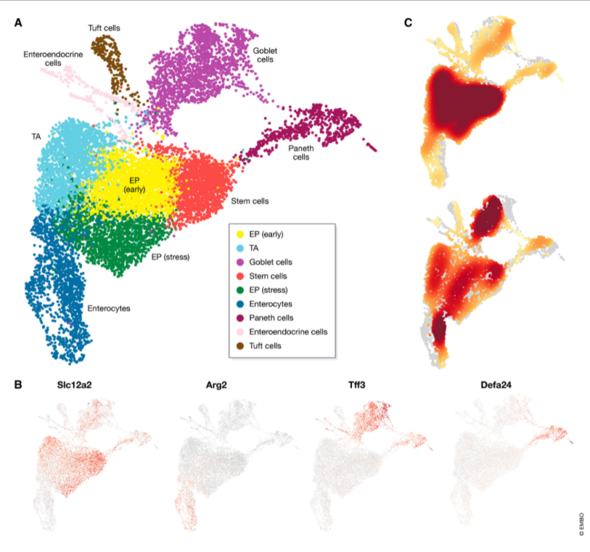
scRNA-Seq Identify Genes between clusters
Luecken, Malte D., and Fabian J. Theis. "Current best practices in single‐cell RNA‐seq analysis: a tutorial." Molecular systems biology 15.6 (2019): e8746.

Slide 9
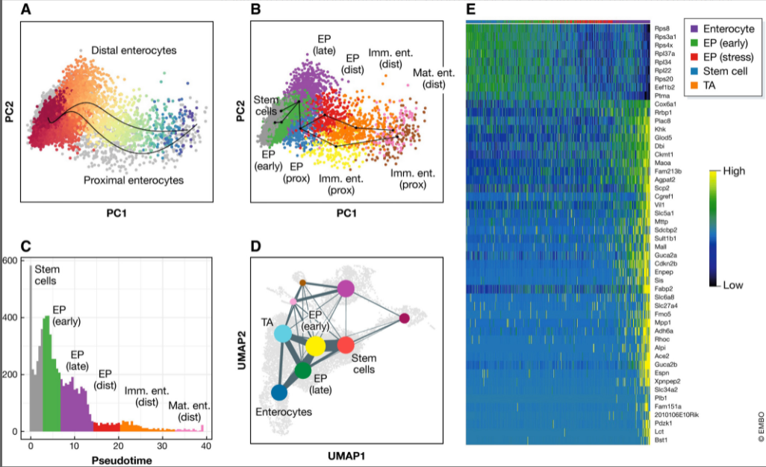
scRNA-Seq Cell State Comparison
Luecken, Malte D., and Fabian J. Theis. "Current best practices in single‐cell RNA‐seq analysis: a tutorial." Molecular systems biology 15.6 (2019): e8746.

Slide 10
H3 scRNA-Seq Evaluation

Slide 11
Evaluation Goals
Identify relevant tools
Data Science Team
Biologists (interactive visualization)
Download multiple datasets
Publicly available
10x Human PMBC example dataset
Dataset mixture of mouse and human
Attempt to analyze datasets throughout entire pipeline
Primarily used
10x Cell Ranger
Visualization Tools
Bioturing (Paid, currently limited licenses)
Loupe (Free 10x Visualization Tool)

Slide 12
Current scRNA-Seq SBG Workflow
Raw Sequencing Data
Publicly Available Raw Sequencing Data
SBG Apps
Apps to build
SRA Download and Extract
I/O
Compress Data
Reformat Files
Unused, but Available
Prepped Sequencing Data (fastq.gz)
Cell Ranger Targeted-Depth
Cell Ranger Count
Cell Ranger VDJ
Cell Ranger Aggregate
Cell Ranger Targeted Compare
Cell Ranger Reanalyze
Cluster & Gene Marker Analysis
Cell Ranger Multi*
*Combines the above

Slide 13
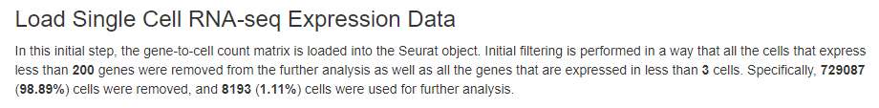
Quality Control Evaluation (Report)
Next few slides represent a pdf report for a scRNA-Seq analysis as possible deliverable for an H3 scRNA-Seq analysis
Report Start

Slide 14
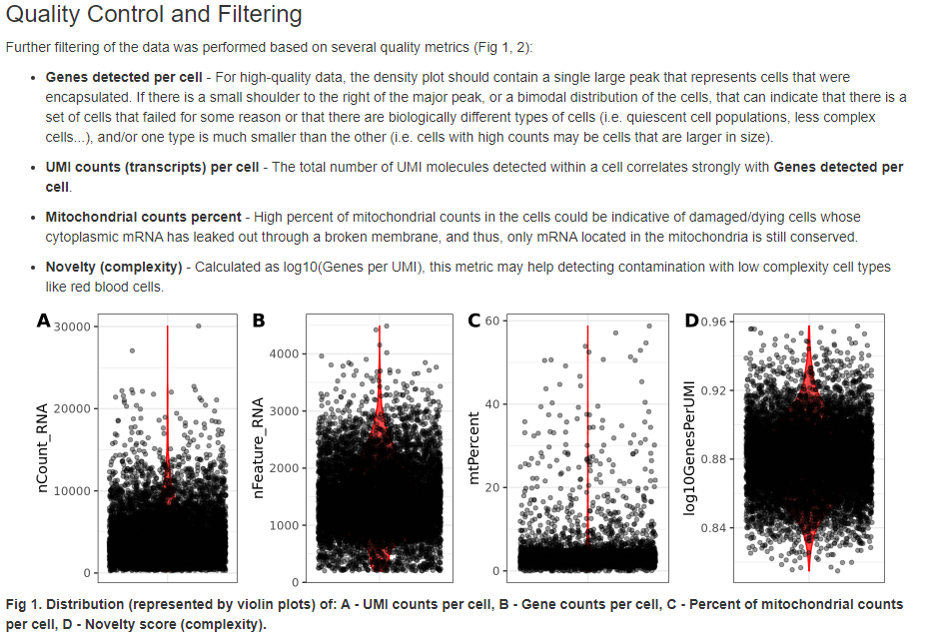
Quality Control and Filtering Part 1

Slide 15
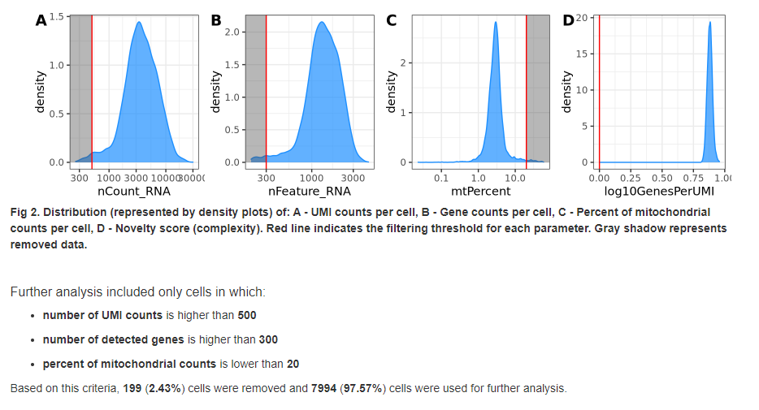
Quality Control and Filtering PT 2

Slide 16
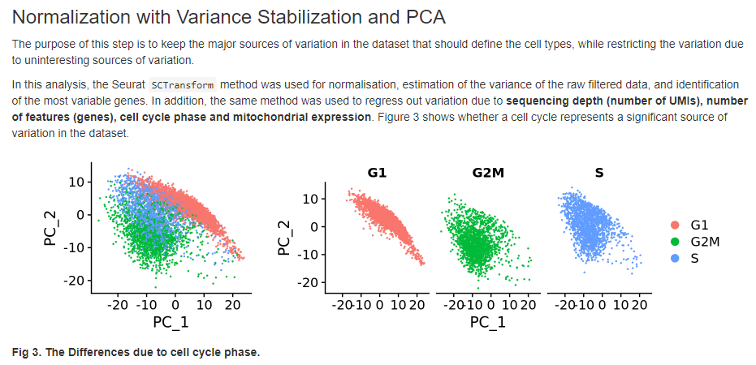
Analyzing Sources of Variation: Cell Cycle Phase

Slide 17
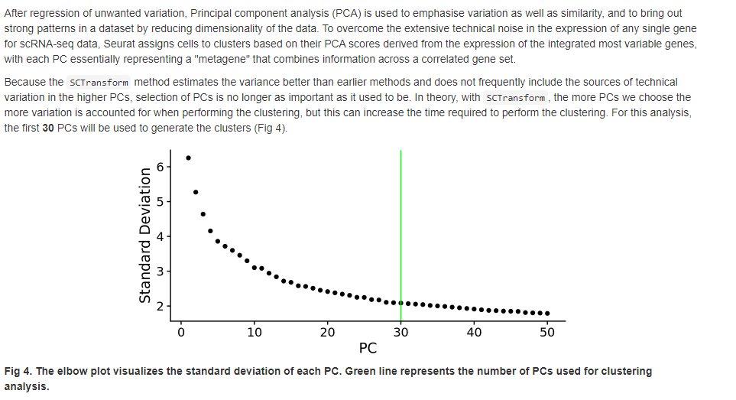
Balancing variation and similiarity

Slide 18
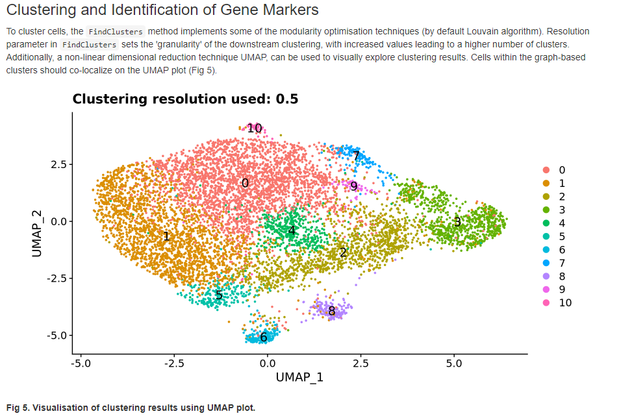
Identifying clusters and gene markers per cluster

Slide 19
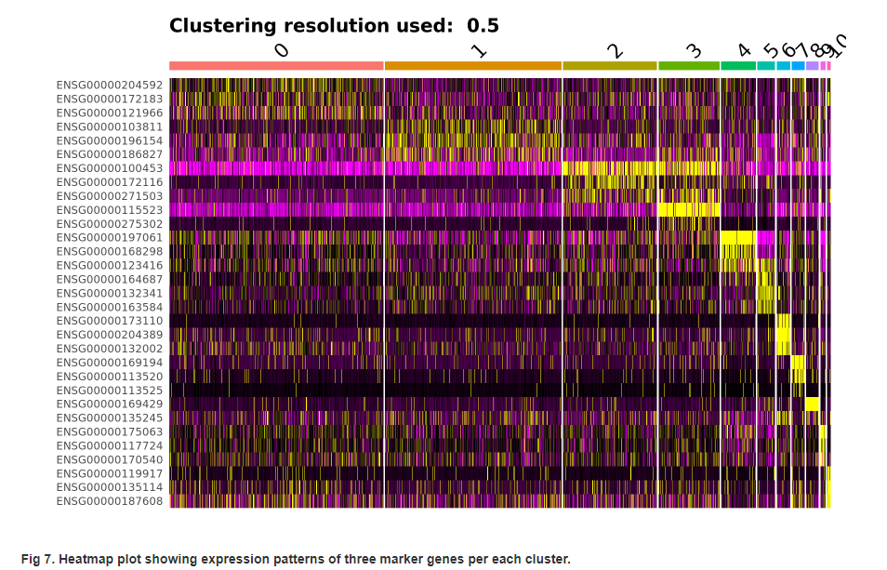
Heatmap Representations between different clusters

Slide 20
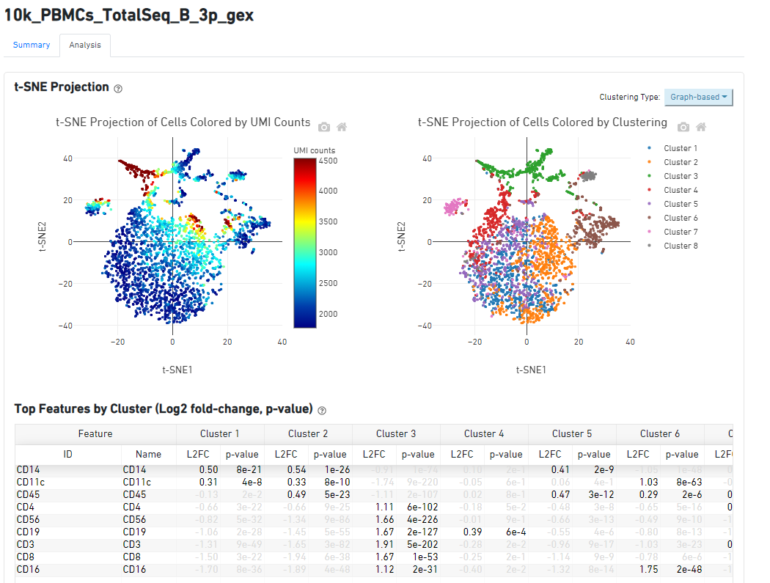
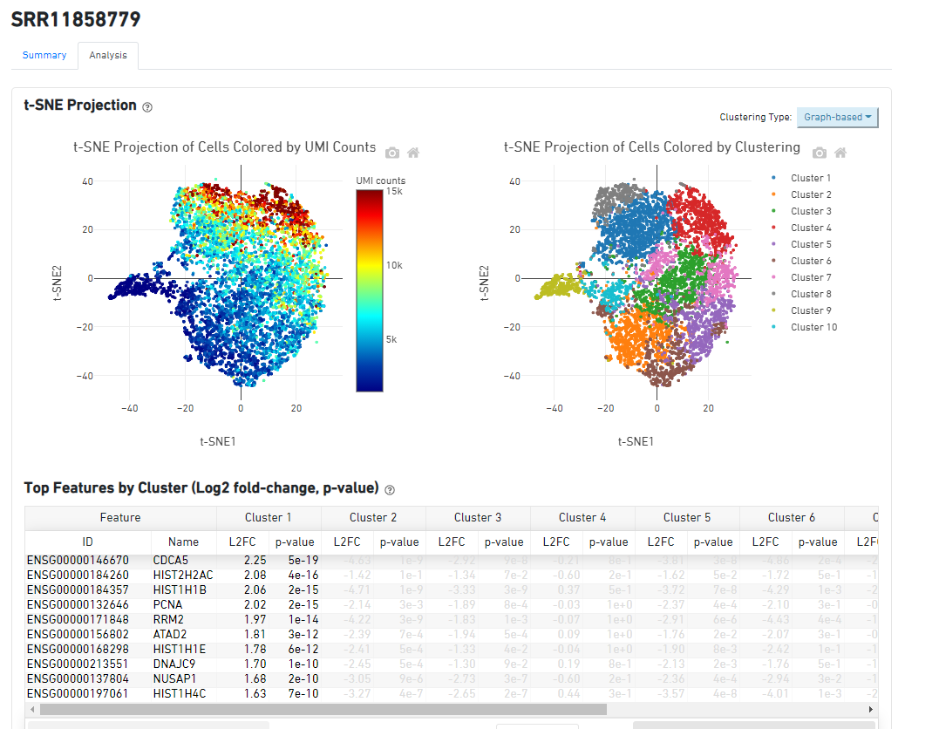
2 Dataset Examples from H3 Evaluation

Slide 21
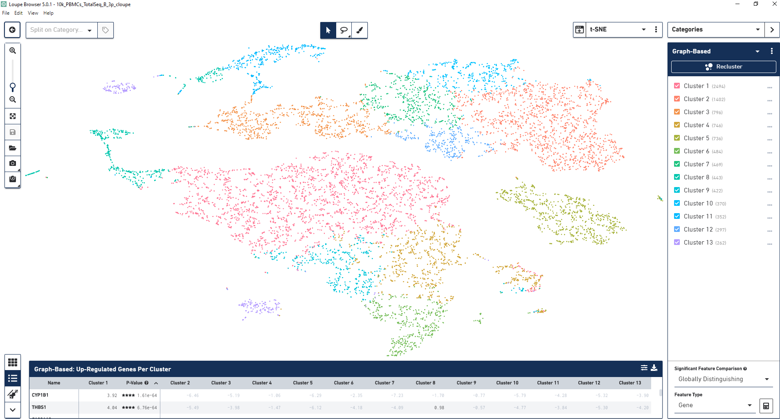
Example Loupe Interactive Visualization

Slide 22
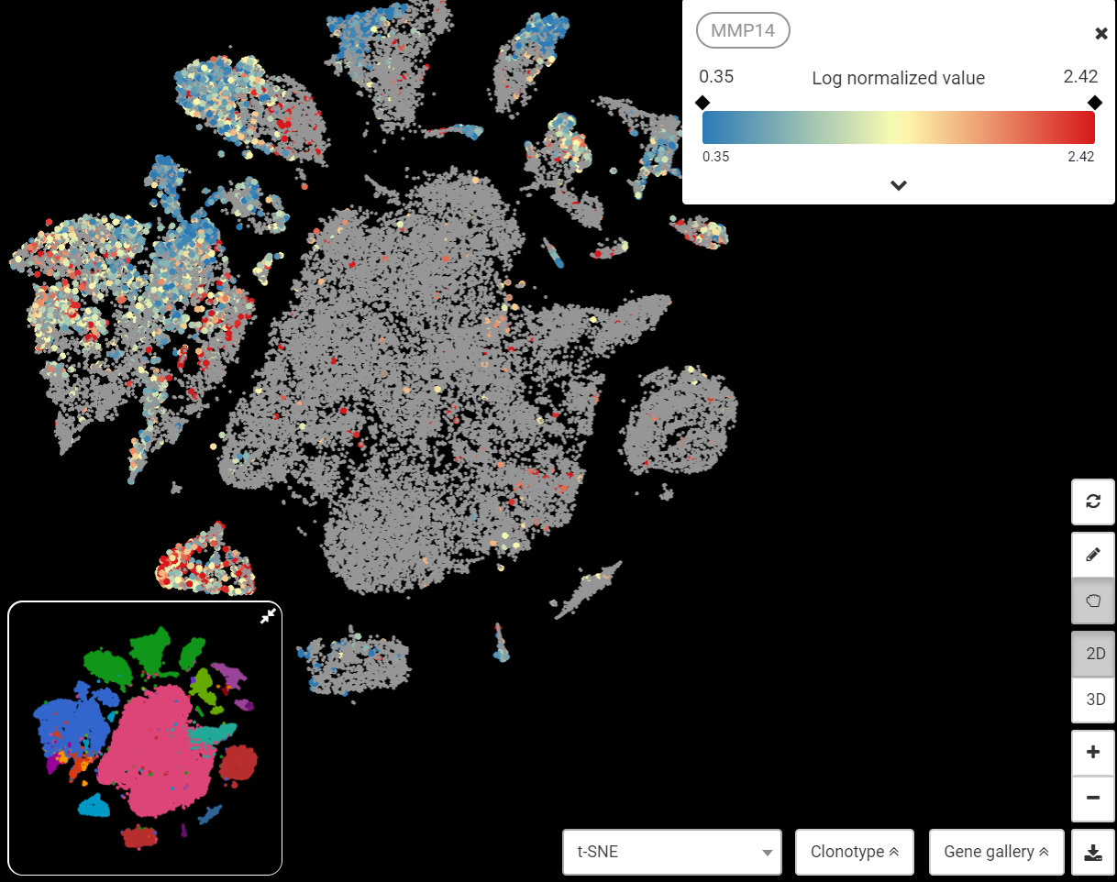
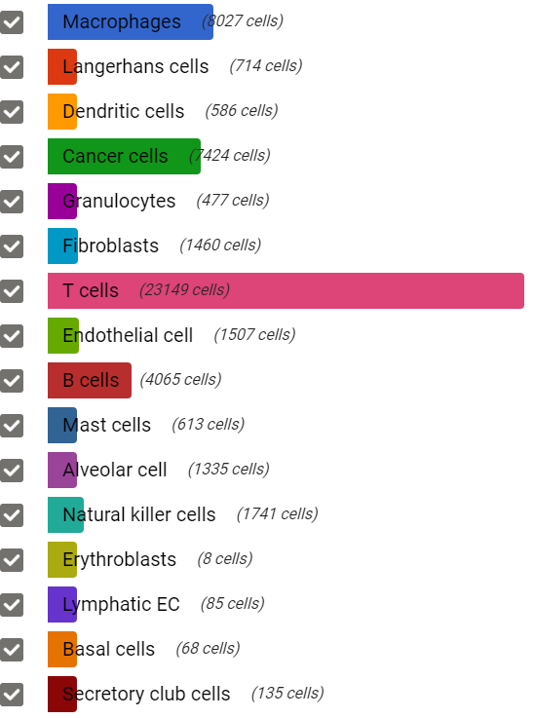
Example Bioturing Interactive Visualization
Cancer cells
Macrophage
Fibroblast
Bioturing
Head and Neck Cancer (GSE103322)

Slide 23
Possible scRNA-Seq Analysis Deliverables
Brainstorming on H3 Fully Desired Deliverables:
QC assessment
Dimension Reduction
Normalization
Cluster Analysis
Cell Identity
Cell State
Comparisons of the above between biological states
Dashboard & Report representation
A Loupe data file for on your laptop visualization
Trajectory Analysis
Analyze publicly available scRNA-Seq data
Data output for extended analysis
Completed
Improvements Desired
Not Available in SBG

Slide 24
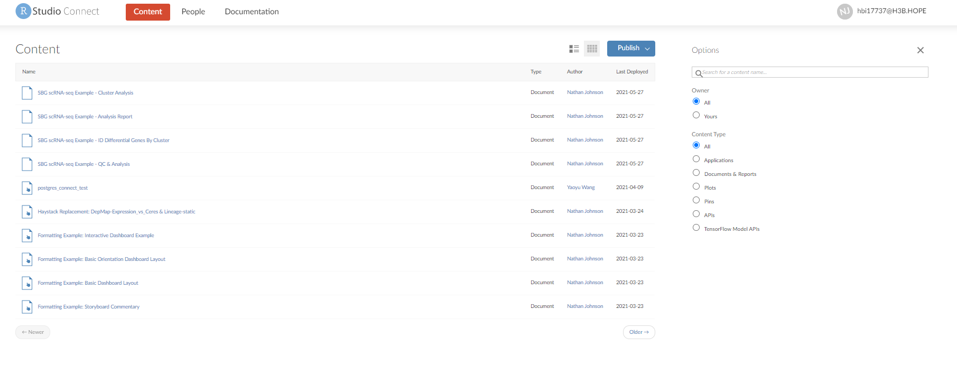
Host Dashboards OR Reports Genomic Infrastructure Improvements

Slide 25
Backup

Slide 26
Number of New scRNA-Seq Tools
Zappia L, Phipson B, Oshlack A. "Exploring the single-cell RNA-seq analysis landscape with the scRNA-tools database", PLOS Computational Biology (2018), DOI: 10.1371/journal.pcbi.1006245

Slide 27
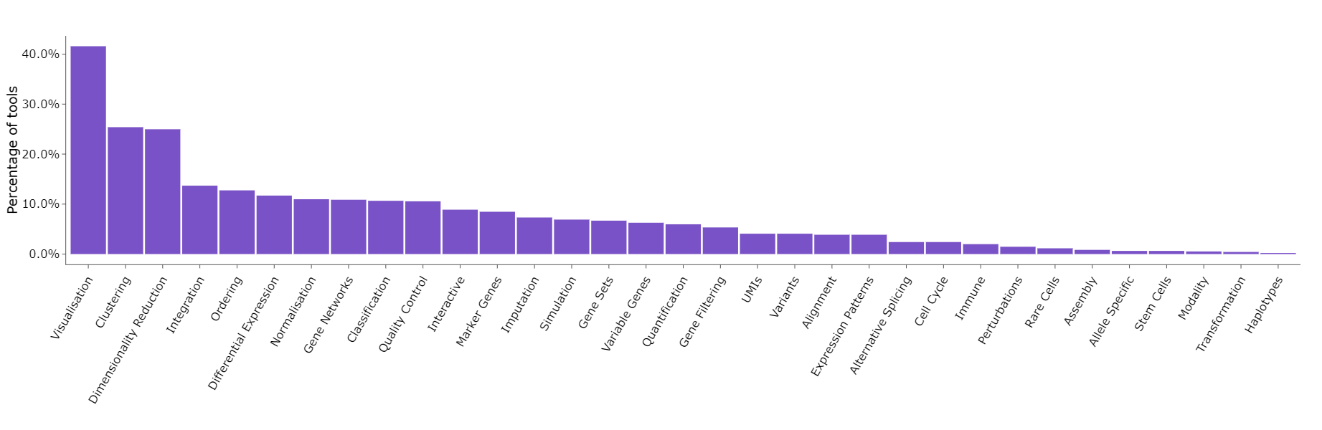
Categories of tools (June 2021)
Zappia L, Phipson B, Oshlack A. "Exploring the single-cell RNA-seq analysis landscape with the scRNA-tools database", PLOS Computational Biology (2018), DOI: 10.1371/journal.pcbi.1006245

Slide 28
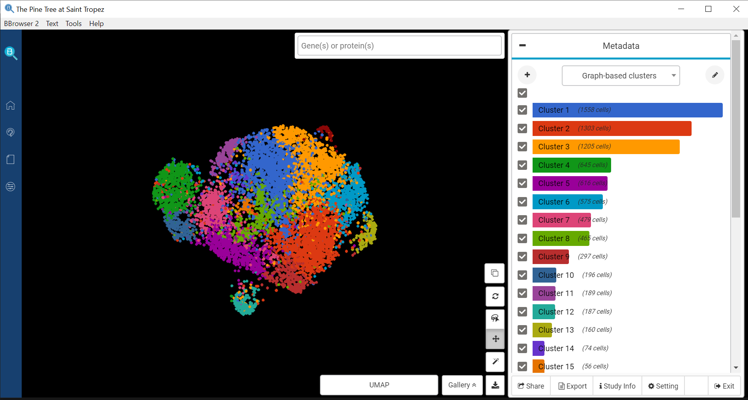
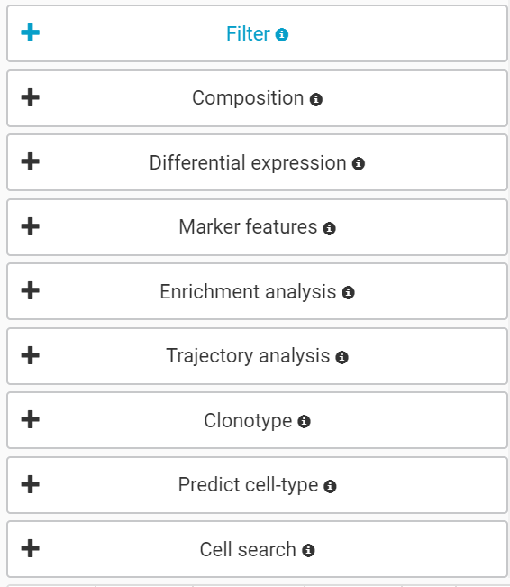
Bioturing Input from H3 SBG Seurat File Run
Required supplied criteria for the below

